Slide 1



So you want to build a Badge!?!
Part 2

Slide 2
Agenda
Who are We
Who Am I / Disclaimer
Common Terms
Schematic Editor
Symbols
Footprints
PCB Editor
Layout
Traces

Slide 3






Who we are
BadgePirates
Building Badges for Fun and No Profit
Badges and Electronics (Learn to Solder kits)
PCBs Built = 20,000
Convention Badges = 21 over the past 5yr
+ countless SAO (Shitty Add-Ons)
Misc Dev Boards
Codex
Mafia

Slide 4
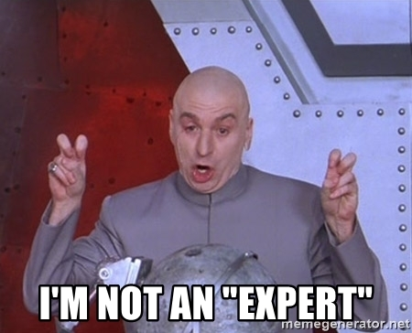
Who am I Disclaimer
FG ≠ Expert
Not an Electrical Engineer
Never even took a class
Trial and Error (A Lot)
Day Job – Principal Incident Response Consultant
I might curse

Slide 5
Common Terms

Slide 6
KiCAD (KEE-kad) 6 – electronic design automation (EDA) suite - OpenSource
Schematic – How the Circuit works with its symbols
Symbol – pictogram used to represent various electrical and electronic devices or functions, such as wires, batteries, resistors.
Footprint – "The area occupied or affected by something“(1)
PCB
(1) – Oxford Dictionary

Slide 7
Schematic Editor

Slide 8
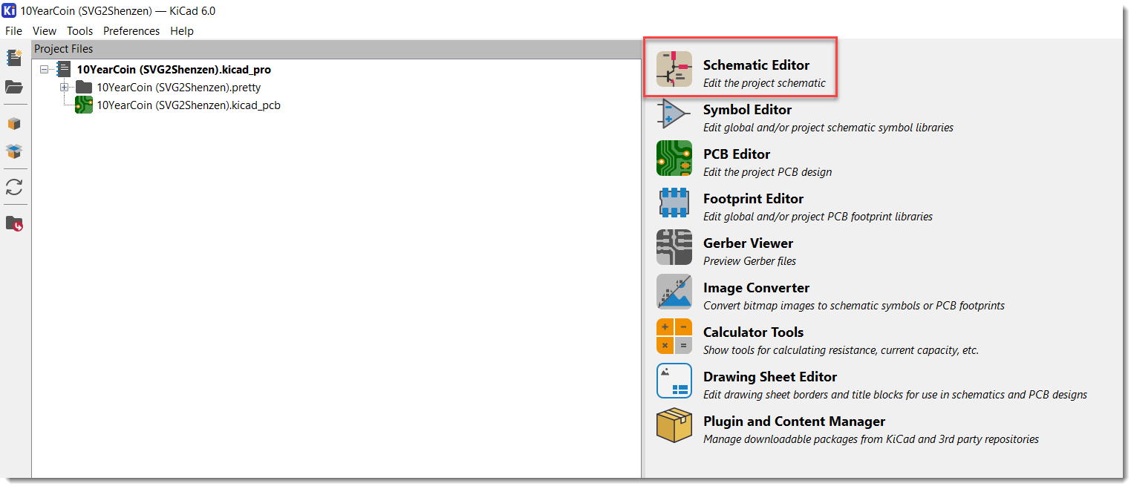
Opening of Schematic Editor

Slide 9
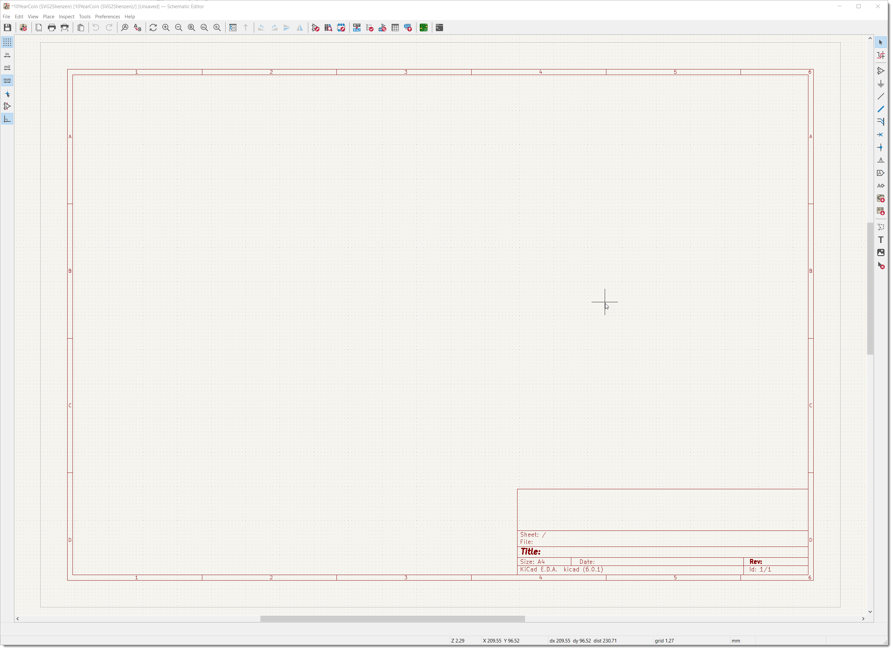
Layout of Schematic Editor

Slide 10
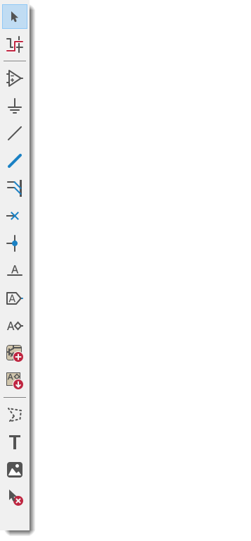
Layout of Schematic Editor
Add Symbol
Add Power Port
Add Wire
Add No Con Flag

Slide 11
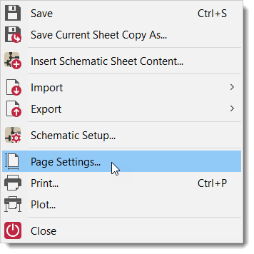
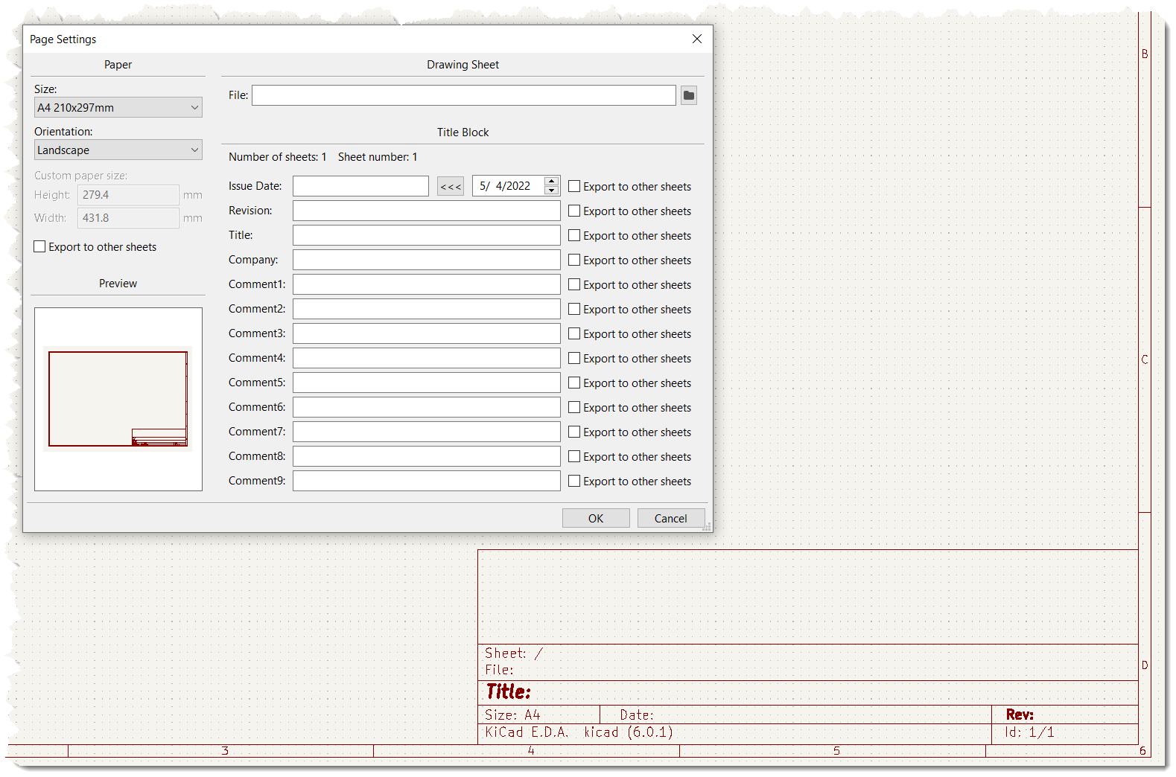
Layout of Schematic Editor
Electrical Rule Check
Symbol Editor
Footprint Editor
Assign Footprint
SAVE

Slide 12
Adding a Symbol
Link to <Adding Symbols to Schematic.mp4>

Slide 13
Wires
Link to <Adding Wire and Ground Symbol.mp4>

Slide 14
Footprints
Link to <Adding Footprints.mp4>

Slide 15
RUN ERC
Link to <RunERC.mp4>

Slide 16
PBC Editor

Slide 17
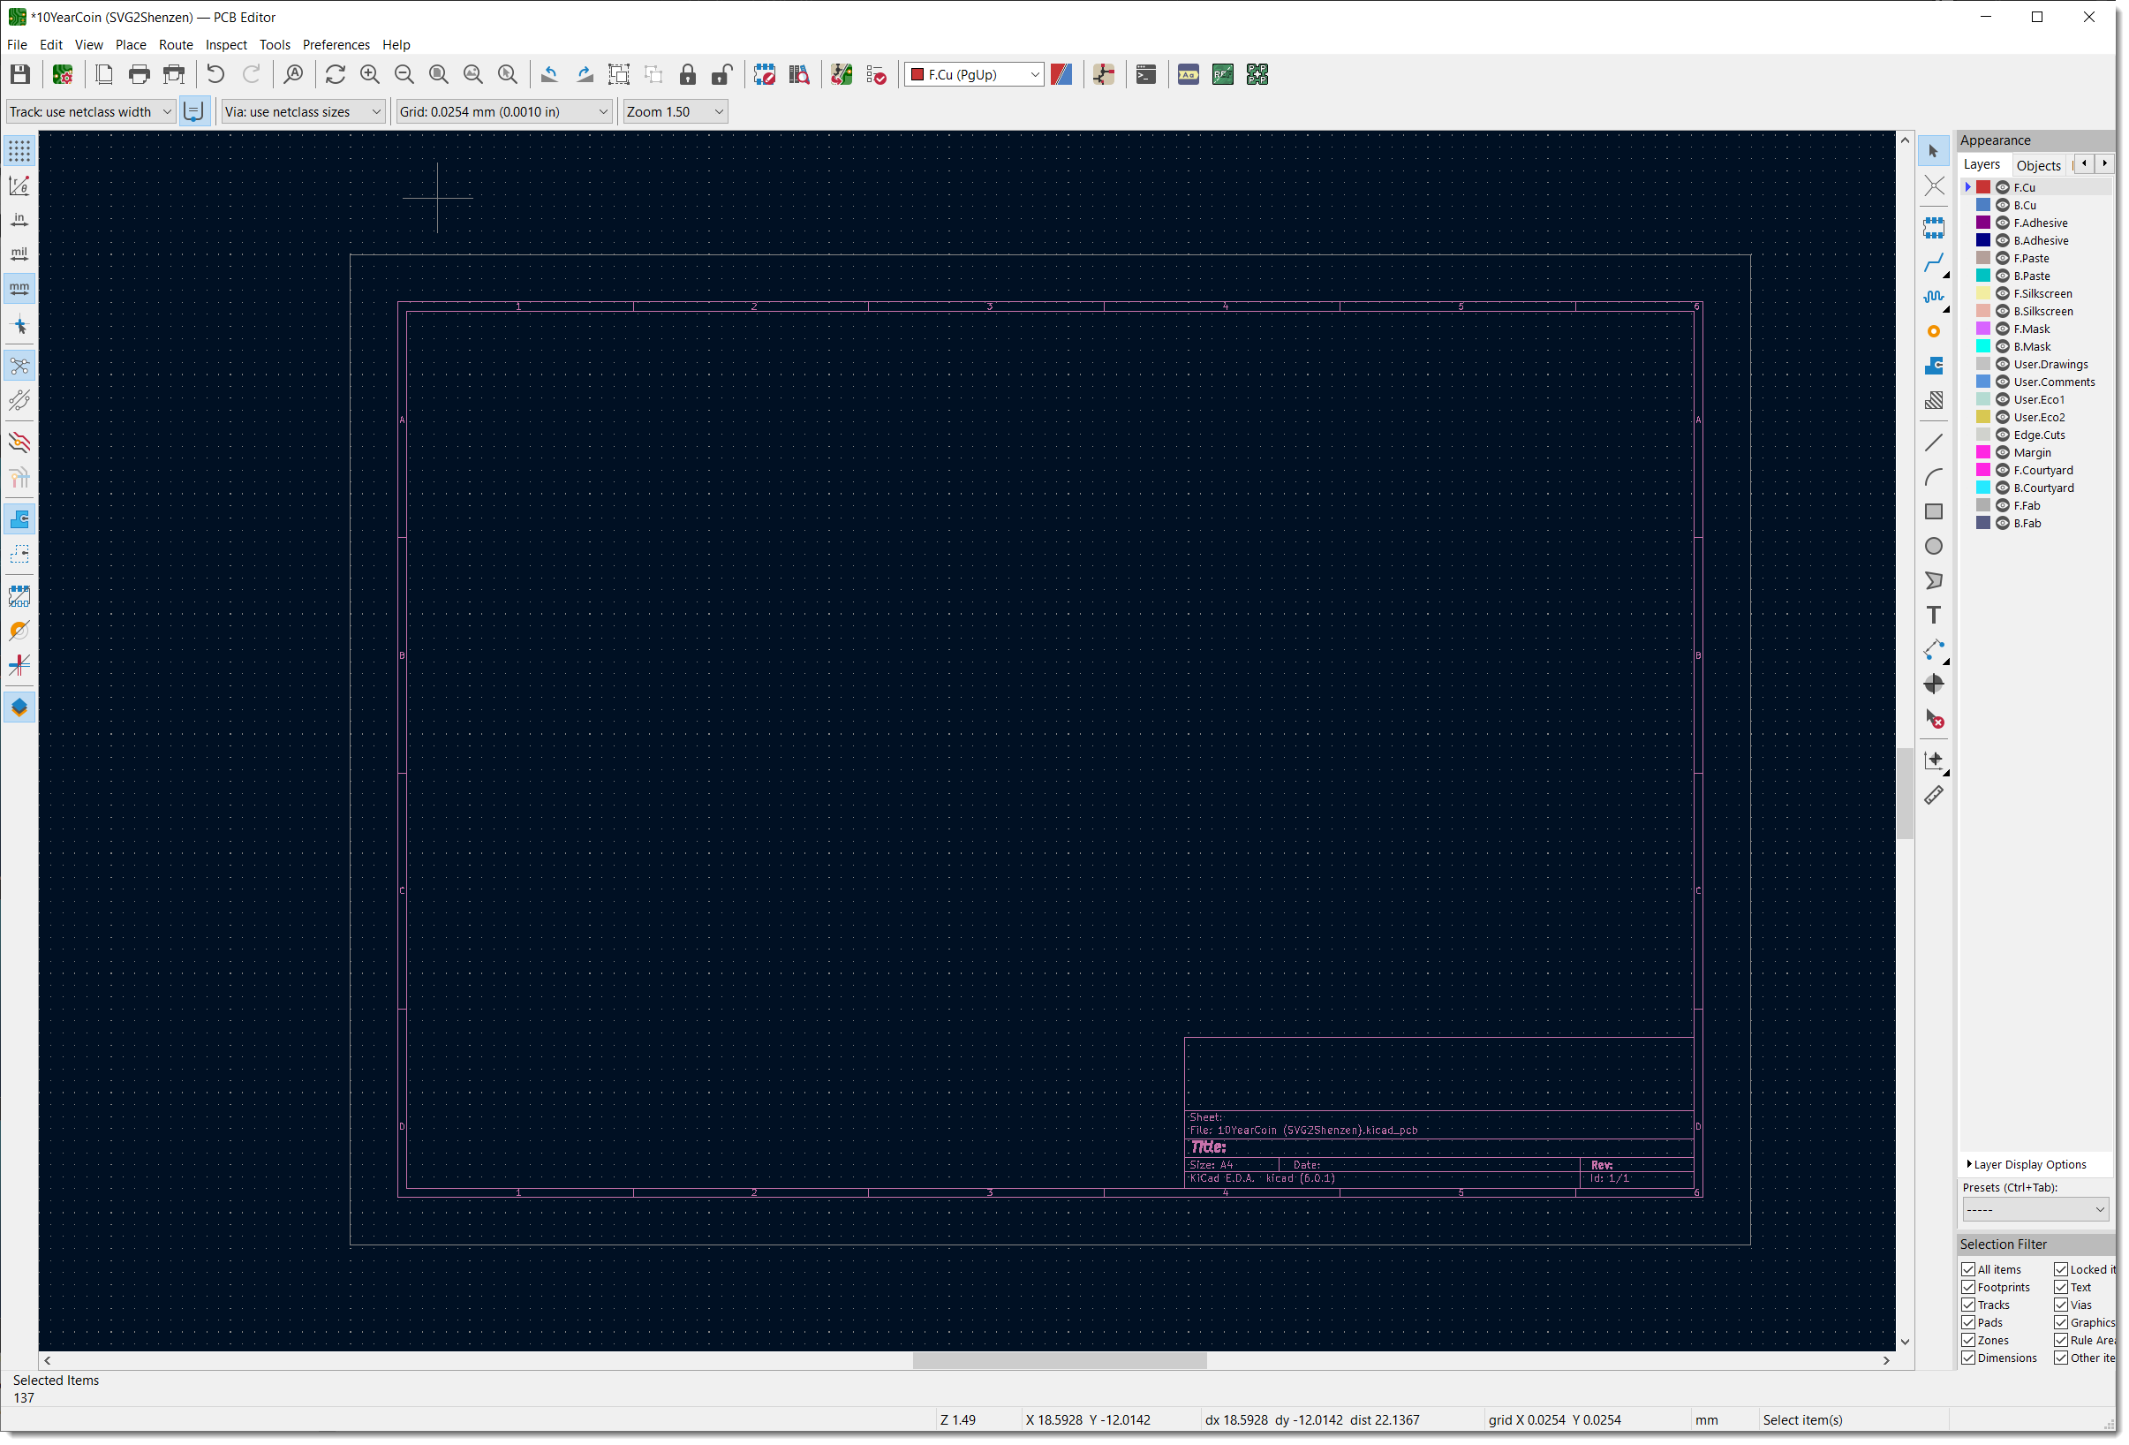
Layout of PCB Editor

Slide 18
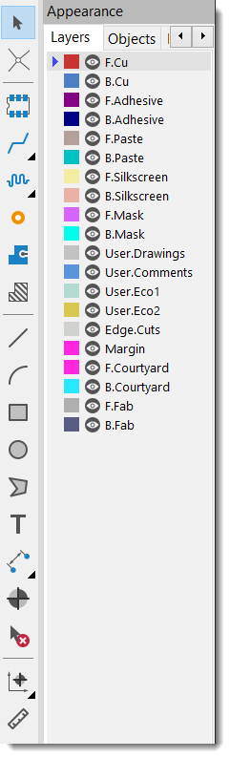
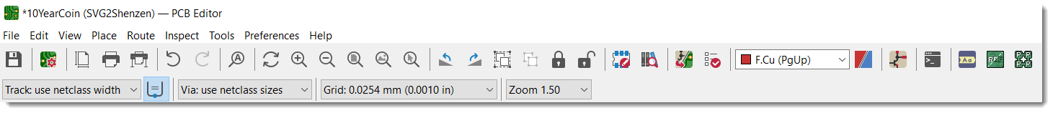
Layout of PCB Editor
Select
LAYERS
Add Footprint
Trace
Via
DRC
Layers
PLOT
Save
Text
Update from Scchmatic

Slide 19
Adding Footprints from Schematic
Link to <Adding Footprints to PCB.mp4>

Slide 20
Placing footprints
Link to <Placing Footprints.mp4>

Slide 21
Traces
Link to <Traces.mp4>

Slide 22

RUN DRC
Link to <Run DRC.mp4>

Slide 23
Next
How to Export to “Gerbers” and Submit to Fab Shop
Assembly
Advanced – Creating Logos
Advanced – Creating / Editing Custom Symbols and Footprint
Advanced – Creating a Common Library for Common Components
“Requests”?

Slide 24

Thank You
Questions?

